Slide 1
Working for Fair Voting Maps in Indiana
The League of Women Voters, a nonpartisan political organization, encourages informed and active participation in government, works to increase understanding of major public policy issues, and influences public policy through advocacy and education.
Please Use “Mute” • Turn Off Video & Other Applications
Presented by Andrea Kleesattel, Shulana Kpabar, Jim Allison and Ben Brabson
Notes:
Welcome to “Working for Fair Voting Maps in Indiana.”
My name is Andrea Kleesattel. I will be joined in this presentation by Shulana Kpabar, Jim Allison and Ben Brabson.
Before we start, here are a couple of housekeeping items:
We’re asking everyone to keep their audio and video turned off during the presentation.
We’ll view a short documentary later in the presentation; so please close any files or other programs, open on your computer, to aid with a clear transmission.
There will be time for comments and questions at the end of the presentation. Please jot down questions and comments, or type them into the “Chat,” addressed to “Ask” so that we can respond in the Q&A at the end.
Let’s get started!

Slide 2
Partners for Fair Voting Maps
Thank you to our state and local partners!
ALL IN for Democracy
Bloomington Alumnae Chapter of Delta Sigma Theta Sorority, Inc.
The League of Women Voters:
Bloomington-Monroe County (LWV-BMC)
Brown County (LWVBC)
Indiana (LWVIN)
South Central Indiana (LWVSCI)
Monroe County Branch of the National Association for the Advancement of Colored People (NAACP)
Monroe County Chapter of the National Organization for Women (NOW)
Reverse Citizens United (RCU) of Monroe County
Notes:
Many groups and organizations have partnered to support Indiana’s fight for fair voting maps.
Thank you to the:
local organizations listed on the slide
statewide organizations
LWV Indiana
All IN for Democracy, Indiana’s coalition for redistricting reform
We thank these groups and their members for their support!

Slide 3
Key Points
Representation should be proportional . . .
One Person = One Vote.
Redistricting should be multi-partisan, transparent, and use criteria important to voters and protect communities and common interests. No gerrymandering.
Fair maps should let voters choose their representatives and not the other way around.
Notes:
Here are the topics and the key points we’ll cover in this presentation.
First, representation should be proportional:
fair and equal—one person, one vote, and
accountable to voters, not parties or other interests.
Second, redistricting should:
Include a multi-partisan commission instead of legislators to draw district lines.
Involve a fair and transparent process.
Use criteria important to voters and protect communities and common interests.
prohibit gerrymandering, which
dilutes a group’s strength by cracking voters apart, among many districts, /or/
concentrates the votes by packing a few districts with these voters.
These practices raise the voices of some voters and silence others.
Third, fair maps should:
let voters choose their representatives and not the other way around.

Slide 4
Vote Equality
and Representation
Notes:
To begin, Shulana will offer a little refresher on vote equality and representation.

Slide 5
Vote Equality―One Person, One Vote
The right to vote is fundamental to a democracy.
At its core, is the concept that one person’s vote counts as much as another person’s vote.
Notes:
Thanks Andrea!
The right to vote is fundamental to a democracy.
At its core is the concept that one person’s vote counts as much as another’s.
The Equal Protection Clause of the 14th Amendment guarantees that all of us, and all of our votes, must be treated equally under the law.
Transition: Let’s take a look at what’s involved in electing representatives.

Slide 6
Representative Democracy Involves . . .
Citizens electing officials to represent them.
Representatives elected from voting districts.
Various levels of representation are:
National - U.S. Congress
State – Legislature
Local – Counties, Municipalities.
District boundaries drawn during a process called “redistricting.”
Notes:
We live in a representative democracy.
Citizens elect officials to represent them.
Representatives are elected from voting districts.
We also have various levels of representation, which are . . .
Nationally in the U.S. Congress.
State-wide in the state legislature.
And Locally, in cities, counties, municipalities.
District boundaries are drawn during a process called “redistricting.” We’ll talk about this later in the next section on redistricting.
Voting districts (who draws them and how they are drawn) can determine what kind of representation we receive—which invlolves more than our actual vote.
Transition: Now Let’s look at the U.S. House of Representatives . . .

Slide 7
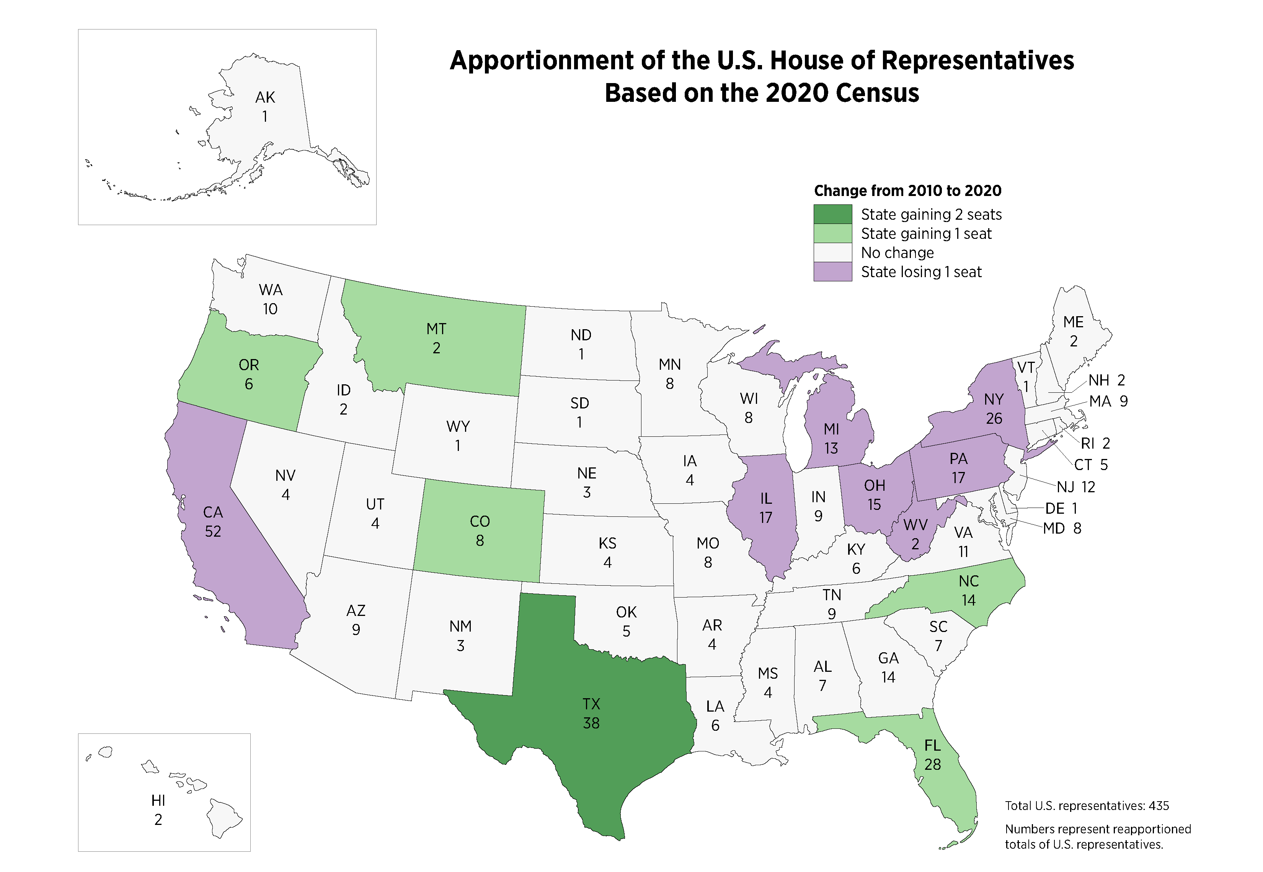
U.S. House of Representatives—435 Seats Total
Each state is assigned a number of Representatives, based on population.
each state has at least one U.S. Representative
elected by popular vote
.
Notes:
This map is based on the recent 2020 Census. It shows the states and the allotments of the 435 U.S. Representatives.
Each state is assigned a number of U.S. representatives, based on population count and elected by popular vote. Each state has at least one U.S. Representative.
Following the 2020 census, California (with the largest population) has 52 representatives, and you can see on the map, Wyoming and Alaska each have 1.
Now take a look at Indiana, with a population of about 6.8 million, we’re allotted 9 congressional representatives in 9 congressional districts
Transition: Next, we have Indiana’s state level representation.

Slide 8
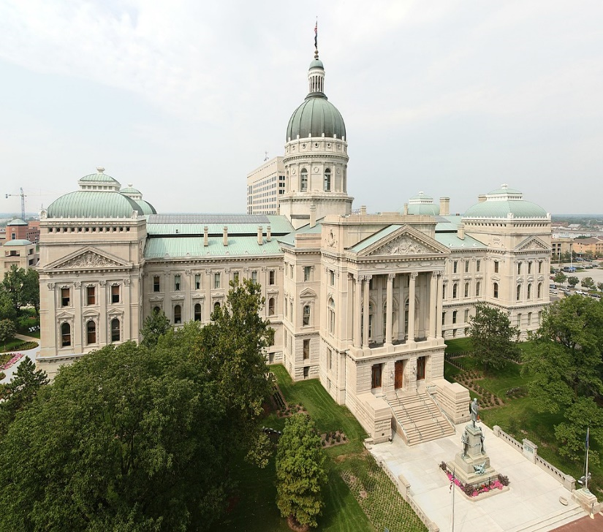
Indiana State Representation
Indiana General Assembly (IGA)
50 state senators
100 state representatives
Elected by popular vote
Notes:
We have 50 state senators and 100 state representatives.
The State’s House and Senate voting districts are redrawn every 10 years, to adjust to population shifts revealed in the U.S. Census.
Next, Jim will focus on redistricting for national and state representation.
He’ll provide details about the process of redistricting and how it can be misused by gerrymandering.

Slide 9
Redistricting and the Effects of Gerrymandering
Notes:
He’ll provide details about the process of redistricting and how it can be misused by gerrymandering.

Slide 10
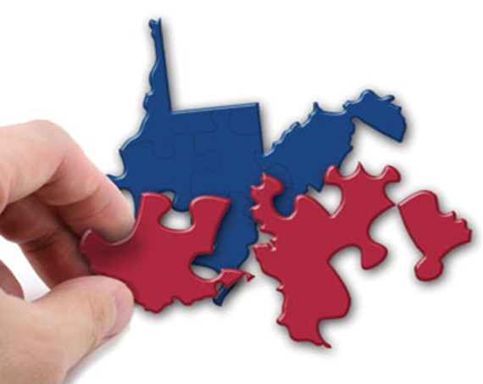
The Redistricting Process Involves . . .
Drawing maps of voting district boundaries occurs:
every 10 years
after the U.S. Census.
Federal law requires:
districts to have roughly equal populations.
districts must be redrawn to account for changes in populations since the last census.
Notes:
The redistricting process involves drawing maps of voting district boundaries after the U.S. Census.
Why do we redraw voting districts?
Federal law requires that districts be of roughly equal population, so every 10 years the districts are redrawn to account for population changes and to re-equalize districts.
States with a . . .
growing population may gain representatives.
decreasing population may lose representatives.
State and national districts will be redrawn in September 2021. The stakes are high because new maps will remain in effect for 10 years. It’s important that the redistricting process be fair, transparent, and politically balanced to ensure that voters choose their representatives and not vice versa.
Transition: Let’s look at who draws the maps in Indiana.

Slide 11
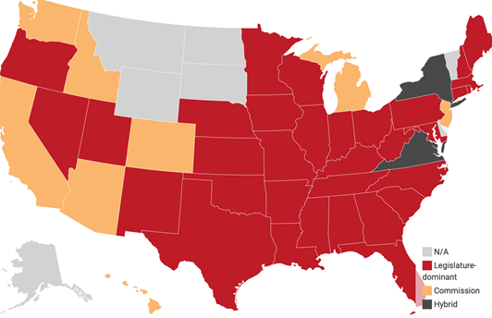
Like Many Others, Indiana’s Legislature Does the Redistricting
Indiana’s Legislature Is Responsible:
Speaker of the House
President Pro Tempore of the Senate
Chair of the Senate Committee on Elections
Chair of the House Committee on Elections and Apportionment
A gubernatorial appointee
Source: State-by-state redistricting procedures - Ballotpedia
Notes:
This map shows redistricting methods in the U.S. by state.
Notice the:
33 states in red, including Indiana, where state legislatures control the process.
The five members who oversee Indiana’s redistricting process are listed.
Commissions are used in some states (shown in yellow) . . . Why? Because legislators are not independent. They are members of political parties, with a high stake in the redistricting process and election outcomes.
In Indiana, both chambers of the legislature and the governorship are controlled by one party. The Brennan Center for Justice says, “Single-party control of map drawing is by far the biggest predictor of redistricting abuses.” (such as gerrymandering).
Transition: Let’s look at an example of what can happen when politicians control the process.
(Source: The Redistricting Landscape, 2021-2022.
2021_2_State of Redistricting.pdf (brennancenter.org)

Slide 12
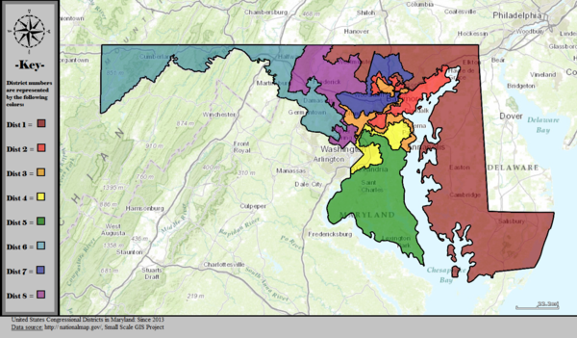
Redistricting to Advantage One Party: Gerrymandering
Both parties gerrymander.
Maryland is an example of
a Democrat-controlled
legislature limiting the impact of Republican votes.
In 2010, Project REDMAP targeted Indiana’s House of Representatives.
2011. Maryland Redistricting
Notes:
Gerrymandering is an abuse of redistricting. First, a bit of history . . .
In 1812, Massachusetts Governor Elbridge Gerry approved district maps that gave his party an advantage in how representatives were chosen for the state legislature. The map produced was said to resemble a salamander; hence, the name “gerrymander.” Gerrymandering is considered a corruption of the democratic process because it is intentional and always done to advantage one party over another.
Both political parties gerrymander. The map above shows how Democrats redistricted Maryland in 2011. They redrew U.S. House District 6 (upper left, light blue) to make it less Republican. The U.S. Supreme Court acknowledged the gerrymander but considered challenges to political redistricting as primarily a political, rather than a judicial question.
In the last 15 years, gerrymandering has become much easier to do because of sophisticated computer-mapping programs. In 2010, Republicans used mapping tools with Project REDMAP and targeted many states’ redistricting efforts. Indiana was one of the states targeted and Republicans retook control of the Indiana House of Representatives.

Slide 13
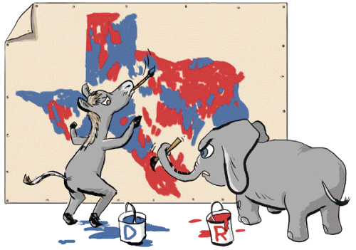
“The Man Who Rigged America’s Election Maps”
https://www.youtube.com/watch?v=KpamjJtXqFI
Notes:
Now let’s watch a 7-minute video that shows the effects of redistricting in North Carolina. As the Republican State Leadership Committee, which created Project REDMAP, says: “Maps matter: (they are) the first tool in winning elections.”
As you watch the film, pay attention to the terms “cracking” and “packing,” two gerrymandering strategies that allow politicians to pick their voters.
And keep in mind that both parties have been guilty of gerrymandering.

Slide 14
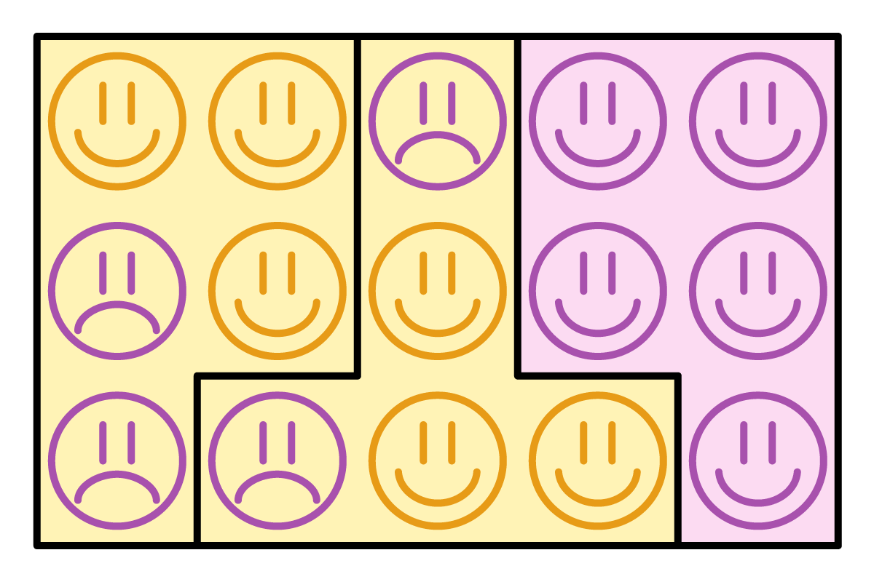
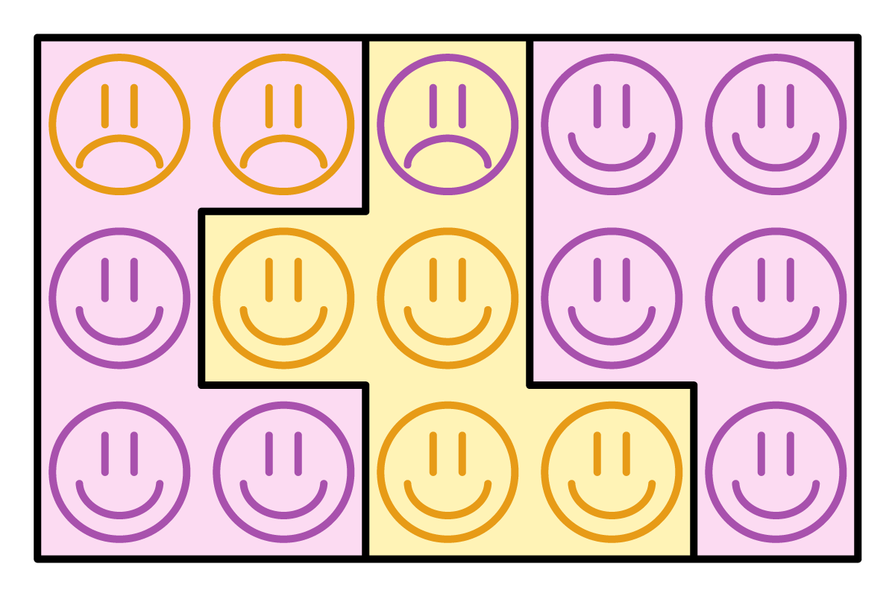
Gerrymandering Made Easy—Example with 15 Voters
Yellow Party = 6 voters. (6/15 or 40% of voters)
Purple Party = 9 voters. (9/15 or 60% of voters)
Yellow Party wins 2 out of 3 district seats. Purple Party wins 1 out of 3 district seats.
Yellow Party wins 1 out of 3 district seats. Purple Party wins 2 out of 3 district seats.
Notes:
As we saw in the video, gerrymandering is easy to do, especially with the computer mapping tools available today.
These two graphics show 15 voters—
6 Yellows and 9 Purples, divided into 3 districts.
At left, we see gerrymandering--because the minority Yellows, with 6 out of 15 voters or only 40% of the popular vote, won most of the districts, i.e., 2 out of 3 (67%) district seats. The majority Purples, with 9 out of 15 voters or 60% of the votes, won only 1 of the 3 (33%) district seats. This violates proportional representation.
We can easily draw a fairer map, as shown in the graphic on the right. In this map, the Yellows, with 40% of the votes, win 33% of the seats. And the Purples, with 60% of the votes, win 67% of the seats. The map on the right is a better definition of “fair” or proportional representation, where a political party’s share of seats is proportional to its share of the popular vote.
So, the slide on the left shows how easy it is to make a gerrymander, and the slide on the right shows how easy it is to unmake one. You don’t have to move voters around. Just the lines on a map.
Transition: Let’s examine how gerrymandering affects voters.

Slide 15
How Does Gerrymandering Affect Indiana Voters?
Loss of proportional representation
Votes cast for U.S. Congress
were split – 40/60
Seats won were split 22/78
Source: https://enr.indianavoters.in.gov/site/index.html
Notes:
The video showed how politicians can use redistricting to pick their voters. Thomas Hofeller called it “an election in reverse.”
One of the ways gerrymandered maps affect voters is by a loss of proportional representation. The principle of “one person equals one vote.”
The bar chart shows what happened in Indiana’s 2020 election for our 9 U.S. Congressional seats. The left bar is “Votes Cast.” 41% were for Democrats and 59% for Republicans. Roughly a 40 to 60 split. Based on this 40/60 ratio, you would have expected Democrats to win at least 3 of the 9 congressional seats and Republicans to win at least 5 of the 9 seats. But just like in the video of North Carolina, this didn’t happen.
Now look at the bar on the right for “Seats Won.” Republicans won 78% of the seats (7 of the 9) and Democrats won 22% of the seats (only 2 of the 9 seats). This is not proportional representation.
Although not shown, lopsided majorities were also seen in the 2020 state legislature elections. Republicans won 71 of 100 House seats (71%) and 39 of the 50 Senate seats (78%). Why did Republicans win disproportionally more seats in all of these races?
The answer is, because district lines were drawn to advantage one group. In gerrymandered districts, legislators choose their voters instead of the other way around. This is harmful to our democracy.
Transition: Let’s look at other ways gerrymandering affects voters.

Slide 16
How Does Gerrymandering Affect Indiana Voters?
Loss of competitive districts
Creates “safe districts”
Teacher salaries
Climate change
Source: Indiana Election Results
Notes:
Gerrymandered maps lead to a loss of competitive districts. The left bar chart is for the House. The right bar chart is for the Senate. About a third of both chambers ran unopposed in 2020. Since 2011, between one-fourth to one-third of general election candidates have run unopposed. In these races, the election outcome is essentially decided in the primary.
Loss of competitive districts creates “safe districts.” With little competition, politicians feel safe in their districts. They can ignore what voters want and champion legislation favored by the controlling party or other outside influences. Let’s examine the relationship between whom we elect and the legislation that gets passed. Consider two examples:
Teacher salaries: According to the 2020 Hoosier Survey, a majority supports teacher pay raises. Hoosiers also report that the quality of public schools has declined. The 2021-23 state budget increased K-12 teacher salaries and provided more public funding for schools.
That budget also included robust increases to school voucher programs, diverting a large portion of state funding from public to private schools, even though 90% of students attend public schools. Currently, Indiana has one of the largest school voucher programs in the country yet one of the lowest average teacher salaries. The 2021 modest funding increase still leaves salaries for our public school teachers far behind that of most other states and the national average.
Climate change: According to the 2019 Hoosier Views on Climate Change Survey, 75% of Hoosiers think climate change is real. Yet Indiana legislators passed laws that discourage investment in solar energy and continue to support reliance on fossil fuels.
(References listed at the end.)

Slide 17
How Does Gerrymandering Affect Indiana Voters?
Low Voter Turnout
2012 - Indiana ranked 37 out of 50 states and Washington DC in 2012 and 38th in 2016.
2020 - Even with a record 65% of eligible voters casting ballots, Indiana ranked 43 out of 50 states and Washington DC.
Source: Statistica.com
Notes:
Gerrymandering leads to low voter turnout.
The graph shows where Indiana ranked out of all 50 states plus Washington DC in the last 3 presidential elections.
Indiana’s voter turnout is consistently below the national average and lower than other mid-western states.
Why? Do people think their vote doesn’t matter?
Gerrymandering dilutes a group’s power when it packs some voters into a few districts and disperses or “cracks” them into others. This raises the voices of some and silences others.
Transition: Let’s look at one more effect of gerrymandering before moving on.

Slide 18
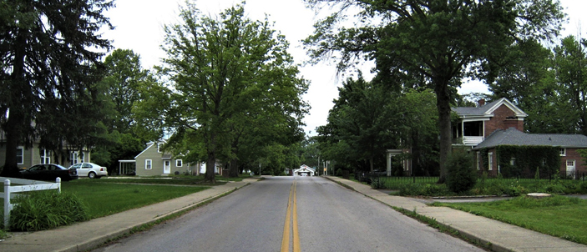
How Does Gerrymandering Affect Indiana Voters?
Harms communities of interest
IN District 61
IN District 60
Monroe County – Bloomington – South High Street
Notes:
Gerrymandering can harm communities of interest. So. High Street in Monroe County-Bloomington divides state representative Districts 60 and 61.
District 60, on the right, extends far into rural areas, where the city’s water supply is located.
Gerrymandering can split towns, counties, school districts, minority communities and other communities with shared interests that benefit from cohesive representation.
When communities of interest are divided, they may no longer have enough members to work as a voting block on issues of mutual concern. You’ll see examples of this in the next section.
Transition: Let’s turn now to some of Indiana’s voting maps.

Slide 19
Indiana Voting Maps
Notes:
Keeping in mind all that we’ve learned about gerrymandering, Ben will show us Indiana’s maps, starting with U.S. Congressional districts.

Slide 20
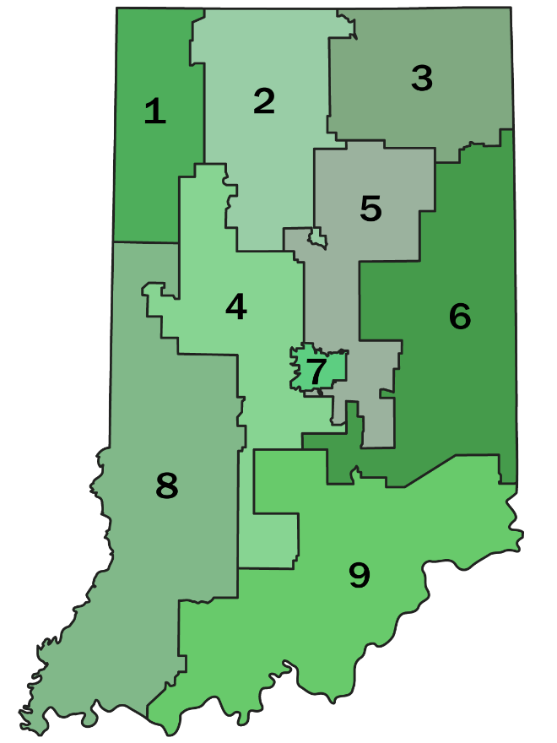
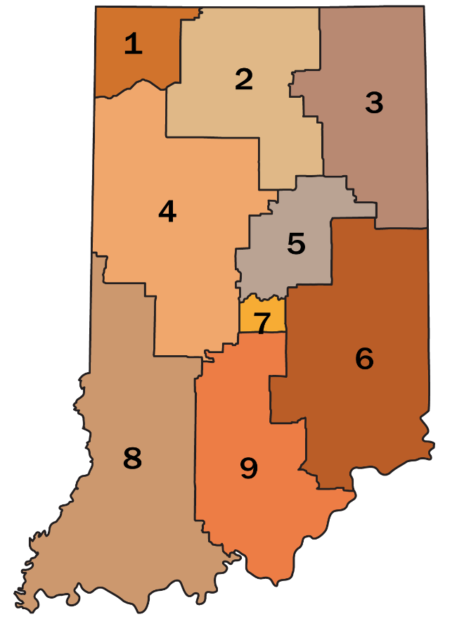
Indiana U.S. Congressional Districts
2001
2011
https://www.stats.indiana.edu/maptools/boundary.asp
Notes:
These U.S. congressional maps were created ten years apart.
On the left, districts created after the 2000 census
On the right, districts created after the 2010 census.
The shape of each district changed. Why can’t we tell the reasons for the changes?
Because the redistricting process is not transparent.
Criteria used, beyond those legally mandated, are not known or discernible from these maps.
Were districts drawn to let voters choose their representatives, or the other way around?
Why do you think our own District 9, on the lower right side, changed so much?
Again, we cannot know because the redistricting process is not transparent.
Transition: Let’s look more closely at District 9.

Slide 21
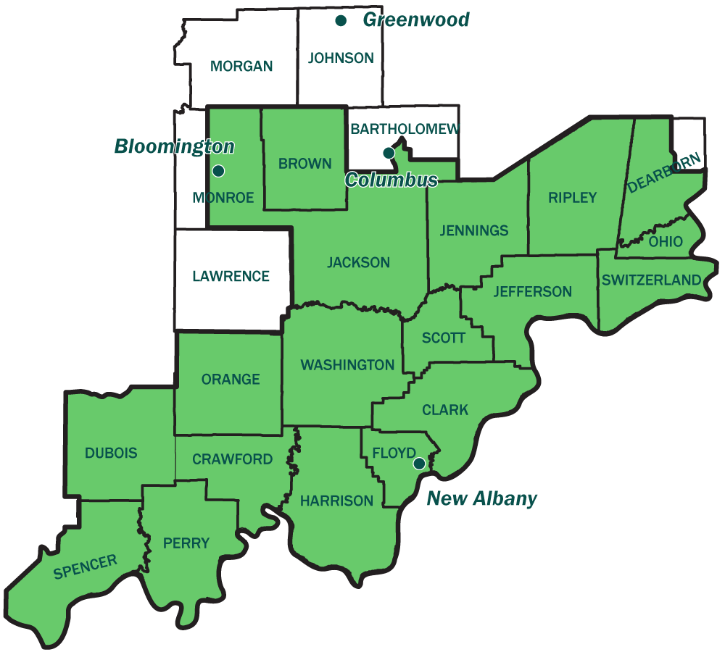
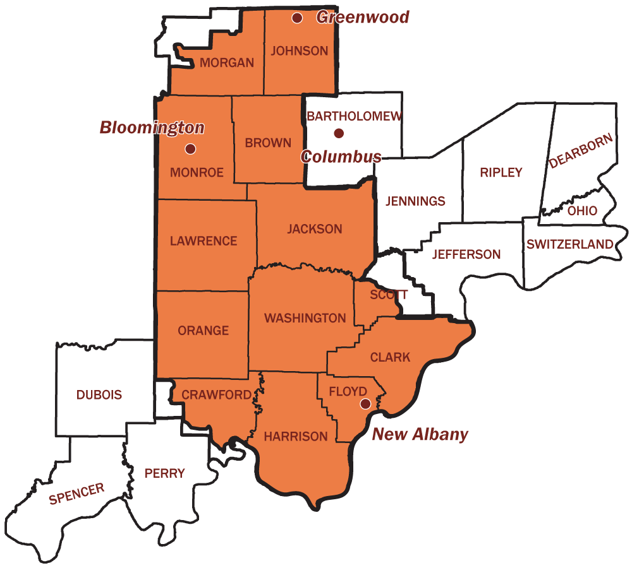
U.S. Congressional District 9
2001
2011
https://www.stats.indiana.edu/maptools/boundary.asp
Notes:
Here are detailed maps of 9th District. Version 2001 is on the left in green. Version 2011 is on the right in orange.
Let’s look at one telling feature:
In 2001, District 9 included two cities, Bloomington and Columbus, with quite a bit in common. District 9 ended in the cornfields just north of those two cities.
But in 2011, Columbus went to District 6, and District 9 ends so far north that it now includes Greenwood, an Indianapolis suburb much less like Bloomington than Columbus.
Would the residents of Bloomington and Columbus have approved of that change? Did it serve community interests?
We have to ask: were districts changed to be more representative of citizens or to let legislators group the voters in their favor?
Transition: Now let’s look at the State Senate maps for Indiana.

Slide 22
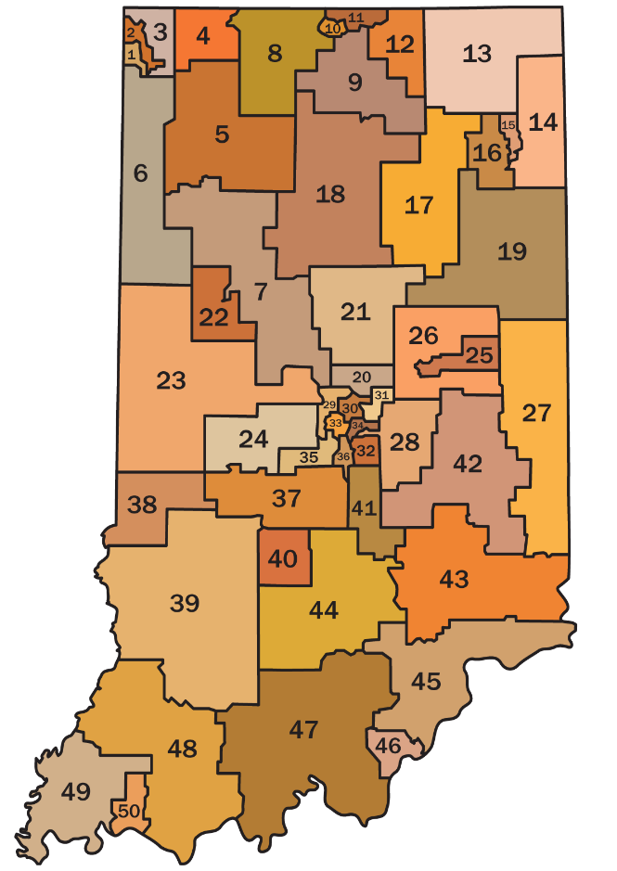
Indiana State Senate Districts
2001
2011
https://www.stats.indiana.edu/maptools/boundary.asp
Notes:
Here are the State Senate maps for 2001 and 2011.
Look at District 39, at lower left, on both maps. In the 2001 map, District 39 looks like a cat arching its back. The part of District 48 that tickles its tummy is the White River basin. It was incorporated into District 39 in 2011. Why?
Again, why do the districts change so much? Were any communities of interest divided or split like we saw earlier in the presentation?

Slide 23
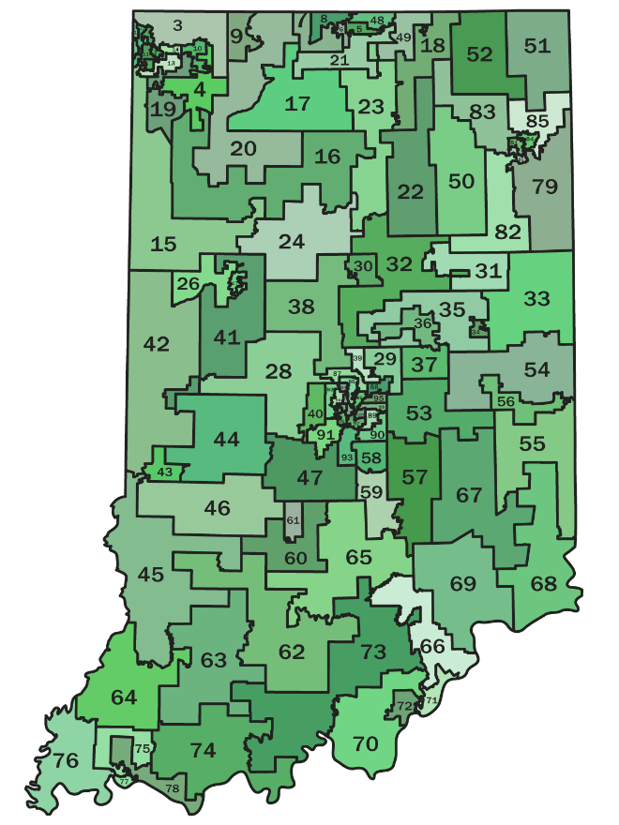
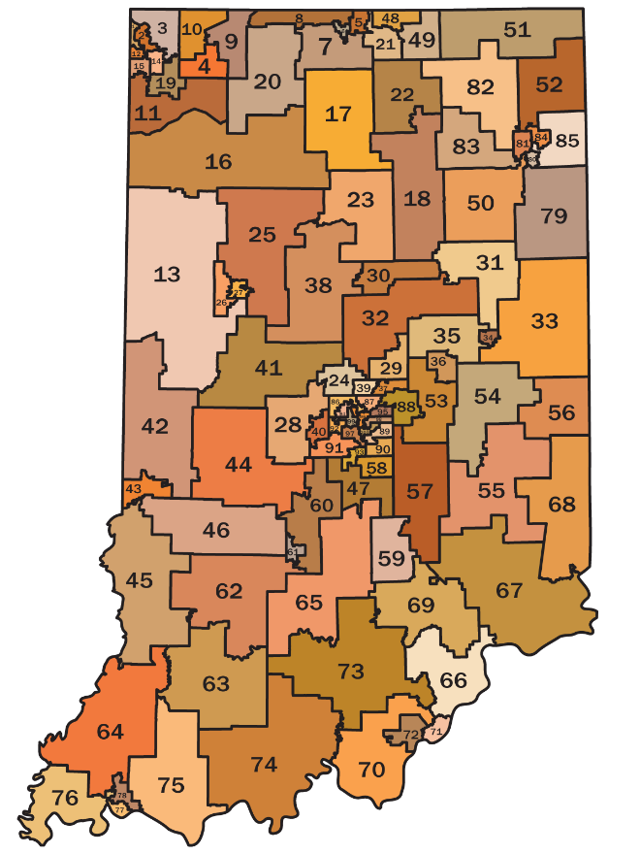
Indiana State House Districts
2001
2011
https://www.stats.indiana.edu/maptools/boundary.asp
Notes:
These are the 100 Indiana State House Districts from 2001 and 2011.
Same old story: How and why were changes made and would the residents have approved?
In the next two slides, we’ll zoom in to look more closely at a house and senate district.

Slide 24
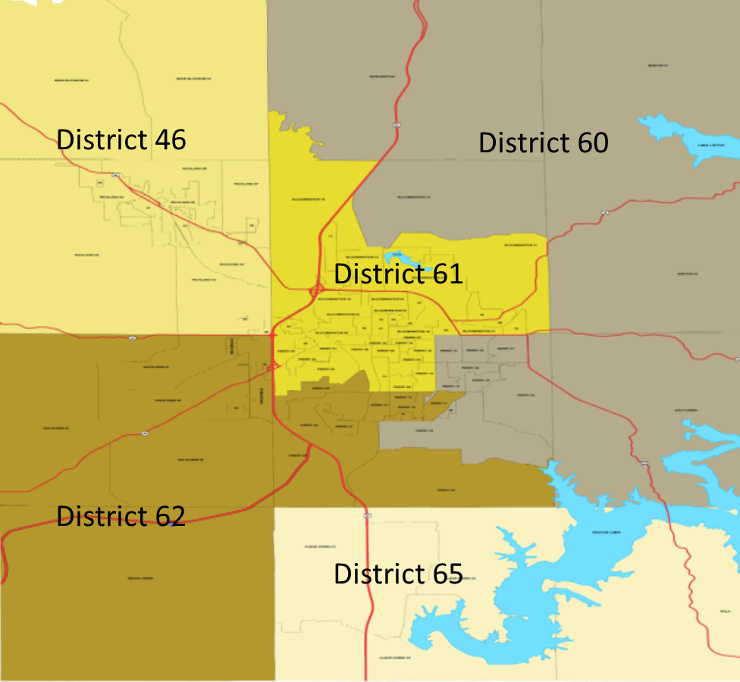
Gerrymandered? Monroe County House Districts
Source: Monroe County Document Center
Notes:
This 2012 map shows portions of the five house districts that cover parts of Monroe County after the 2010 census. The red lines are major roads and thoroughfares. The blue areas are lakes. The map was cropped to fit the screen, so the only district shown in its entirety is District 61.
Packing Democrats into one district (District 61 in the center of the map) reduced the number of Democratic house representatives elected in this area from 2 to 1. Cracking made it impossible for Democrats to win in any of the other 4 districts, all of which extend into other counties.
Let’s think about the effects. Lake Monroe is in the lower right side of the map. It is located mainly in two rural districts, 60 and 65. This lake is the only source of drinking water for residents of Bloomington and parts of Monroe County. This mapping weakens city voters’ influence in state legislation about Lake Monroe. The few Monroe County voters in District 65 are cracked with other counties such as Lawrence, which is not dependent on the lake for its water.
When drawing voting districts, legislators need to consider the voters and the communities of interest that are important to the voters in each area of the state.

Slide 25
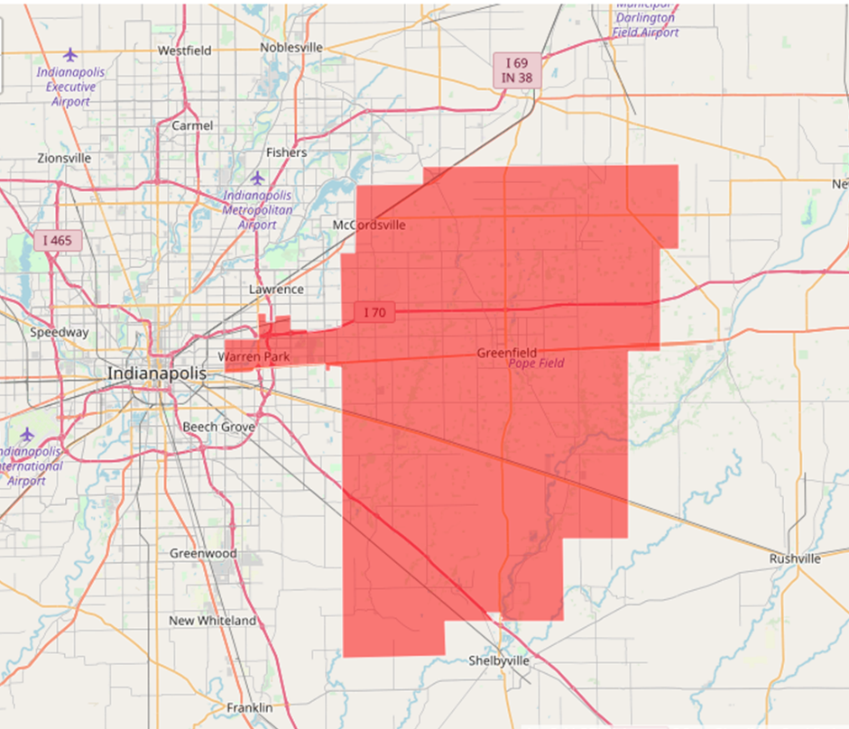
Gerrymandered? Indiana Senate District 28
Source: Indiana Geographical Information System. Obtained from All IN for Democracy.
Notes:
Here’s another example. Senate District 28 is shown in red. Note the funny arm, at left, that reaches westward into Indianapolis.
It cracks a majority Black, urban, and densely populated community on the east side of Marion County and joins it with two majority White, rural counties--Hancock and most of Shelby. The population in the Marion County arm is not large enough to form a decisive voting block for urban issues, so rural issues tend to dominate. The district’s senator lives in Hancock County.
The senator has earned low ratings for his votes on funding for mass transit and public schools. Has he served his urban constituents? Do you think they feel well represented in District 28?
Is it fair to break up communities of interest in this way? Who are voting districts supposed to serve—the voters or the politicians?

Slide 26
Criteria for Drawing Districts and Efforts to Reform
Notes:
From the video and after looking at our maps, we’ve seen some of the ways gerrymandering affects voters.
Transition: Let’s compare Indiana’s criteria for drawing districts with criteria for drawing maps that are more fair. Then we’ll discuss some of the reform efforts here in Indiana.

Slide 27
Compare Criteria for Indiana Maps with Fair Criteria
 | INDIANA MAPS | FAIR MAPS
WHO | Indiana Legislature | Independent commission with diverse membership
LEGAL REQUIREMENTS | Federal Population must be approximately equal Compliance with Voting Rights Act Indiana State Constitution (Art. IV, §5) Contiguous voting districts (all parts of the district are in physical contact with some other part of the district) | Federal Population must be approximately equal Compliance with Voting Rights Act State Constitution Varies by state
REDISTRICTING PROCESS | Majority party assembles a team of legislators, consultants, and mapping experts to draw the maps using computer mapping tools. | Operates transparently Welcomes public input Subject to full disclosure laws
REDISTRICTING CRITERIA | In the absence of full disclosure laws, the criteria and expert input are not required to be shared with the public | Clear and prioritized To the extent possible, promote partisan fairness Protect communities with shared interests (i.e., school districts, counties, towns, racial, minority rights) Reject protection of incumbents and preferential treatment of political parties
Notes:
This presentation is entitled “Working for Fair Maps in Indiana.” So how does the redistricting process and criteria Indiana uses compare with those of fair maps? Let’s compare row by row in this table.
(Cursor on 1st row.) With respect to Who draws the maps, Indiana’s process is controlled by the majority party of the legislature. Research from the Brennan Center for Justice reports that fair maps are best drawn by commissions with diverse representation and partisan balance. They caution against political control of the process. Why? Because:
Politicians aren’t independent, and
May lack diverse representation. (References listed at the end of the presentation.)
(Cursor on 2nd row.) What about legal requirements? All redistricted maps, must meet 2 federal requirements: Districts must be of roughly equal population and must comply with the Voting Rights Act. In 2013 a Supreme Court decision gutted the core protections of the Act. Anyone challenging the way maps are drawn must show discrimination was intentional for it to be declared a racial gerrymander. This is why Hofeller’s papers were so important to litigation in North Carolina. His own records and memos proved gerrymandering was intentional.
Indiana has only one state requirement—contiguous borders.
(Cursor on 3rd row.) How does the redistricting process in Indiana compare with fair maps recommendations? In Indiana, the majority party assembles a team of legislators, consultants, and mapping experts. The mapping experts draw versions of the maps using a computer mapping tool. Modern technology has made it easy to draw biased, yet geographically compact districts, making it harder to spot gerrymandered districts. Taking a different approach, fair maps are drawn transparently and welcome public input and review. They also recommend that the process used be subject to full public disclosure laws.
(Cursor on last row.) Redistricting criteria are very important. In Indiana, criteria used, expert input, and consultants who draw the maps are not transparent to the public. Why?
Fair maps are drawn with clear and prioritized criteria, that to the extent possible
Promote partisan fairness
Preserve and protect communities with shared interests such as school districts, counties, towns, and racial and minority rights
Reject two of the major reasons for gerrymandering:
Protection of incumbents (i.e., do not use incumbent residence)
Preferential treatment of a political party (i.e., maps should avoid packing and cracking to favor voters of one party over another).
The Indiana Constitution guarantees a free and fair election. The question is: do Indiana’s very basic legal criteria and lack of transparency ensure fair maps? Is the process sufficiently impartial when overseen by legislators who don’t have to disclose who is involved and how it is done—what criteria are used to draw districts?
Transition: Which process is fair to voters? Let’s look at how Indiana’s coalition for redistricting reform works for fair maps in Indiana?

Slide 28
Details on Reform Efforts in Indiana
ALL REBUFFED:
Grassroots lobbying
Implementation of 2015 General Assembly recommendations for redistricting reform
Many redistricting reform legislative proposals
WHY?
Partisan gerrymandering
Single-party control leading to safe, uncompetitive districts, and low voter turn-out.
Notes:
Indiana’s coalition for redistricting reform (ALL IN for Democracy) spearheaded grassroots lobbying efforts to implement recommendations from the Indiana General Assembly Interim Study Committee report and worked with legislators to pass redistricting reform legislation. And although none of the bills introduced have been passed by both the Indiana house and senate, grassroots support is building.
Why? Because…
Partisan gerrymandering led to super majorities in both Indiana state chambers and in the U.S. congressional districts.
Under single-party control of the state legislature, districts have grown safer for incumbents, the number of noncompetitive races has increased, and voter turnout continues to rank near the bottom and lower than in other midwestern states.
Would most politicians of either party be likely to relinquish super majorities and single-party control of the legislature if they were in the controlling party? Only if the voters demanded it.
Transition: Are voters demanding change?

Slide 29
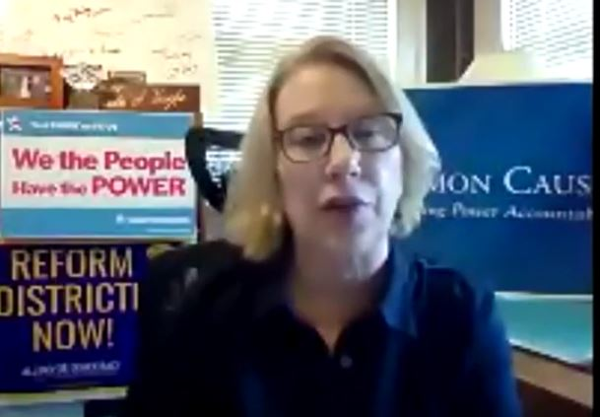
Growing Support for Fair Maps
According to the 2020 Hoosier Survey, a
growing number of voters . . .
Prefer an independent, nonpartisan body to draw maps
Indicate it’s important to
respect township and county boundaries
keep communities in close proximity together
create more compact and geographically uniform districts.
Julia Vaughn,
Policy Director for
Common Cause Indiana
Source: Hoosier Survey 2020 from Ball State University - Bowen Center, page 32.
https://bowencenterforpublicaffairs.org/institutes/policy-research/hoosier-survey
Notes:
The 2020 Hoosier Survey shows a growing number of Hoosiers:
Prefer that the redistricting process be handled by an independent, nonpartisan body (instead of legislators).
Indicate, that when drawing maps, it is important to respect township and county boundaries, keep communities in close proximity together, and create more compact and geographically uniform districts.
Survey data suggest Redistricting Reform efforts are growing in momentum!
Transition: In 2020, Julia Vaughn, Director of Common Cause Indiana and All In for Democracy announced, “If the legislature won’t do what is recommended, we will build our own citizen’s commission and show legislators how redistricting should be done in Indiana.”

Slide 30
Indiana Citizen Redistricting Commission (ICRC)
A New Process to Model Fair Redistricting!
In 2021 ALL IN for Democracy Created a Panel of People and a Process . . .
A Panel of People . . .
Nine members, selected from about 300 applications
Partisan balance (3 Republican, 3 Democrat, 3 neither Republican nor Democrat)
A Process including . . .
Transparency
Public testimony opportunities (completed April, 2021)
Feedback to legislators (report submitted May, 2021)
A web-based mapping tool (Districtr) and regional training sessions for citizens
A contest for citizen-drawn maps, winning maps submitted to the Legislature
Notes:
With the coalition’s goal for 2021 to model how a citizen commission could work, All IN for Democracy created the Indiana Citizens Redistricting Commission (ICRC) in January, 2021. The ICRC is composed of nine members, selected for partisan balance.
The ICRC is not affiliated with the legislature. It is an independent commission, modeling a redistricting process that our legislators could emulate. One that is…
Transparent
Includes public testimony (almost 900 Hoosiers have participated in meetings held across the state and completed in April, 2021)! Hoosier recommendations mirror fair maps criteria.
Feedback to legislators in May 2021. (Recommendations from voters are contained in the final report submitted to legislators in May, 2021. A link to the report is included on the resource page.)
Providing a web-based mapping tool (Districtr) and regional training sessions to enable citizens to draw their own maps.
A map making contest for citizen-drawn maps, with the winning maps submitted to the legislature.
Indiana’s Constitution says: All elections shall be free and equal. The ICRC is serving as a model of how redistricting can help make this so.
Transition: And now to summarize, Andrea will go back over key points covered in this presentation.

Slide 31
Summary
Representation should be proportional . . .
One Person = One Vote.
Redistricting should be multi-partisan, transparent, and use criteria important to voters and protect communities and common interests. No gerrymandering.
Fair maps should let voters choose their representatives and not the other way around.
Notes:
Thank you Jim! We have covered several key points in this presentation. I’ll summarize them briefly.
First, representation should be proportional:
fair and equal—one person, one vote, and
accountable to voters, not parties or other interests.
Second, redistricting should:
use a multi-partisan commission instead of legislators to draw district lines.
involve a fair and transparent process.
use criteria important to voters and protect communities and common interests.
prohibit gerrymandering―cracking and packing districts to raise the voices of some voters and silence others.
Third, fair maps should:
let voters choose their representatives and not vice versa.
Transition: Are you fired up to support fair maps in Indiana? I hope so. It will take all of us to impress upon our legislators that we can’t wait another 10 years—we need fair maps in 2021. Let’s look at a few actions you can do today before we stop for Comments and Q&A!

Slide 32
What You Can Do

Slide 33
Citizen Action Requested and Urged!
Contact your State Senators and Representatives. Let them know you want fair maps drawn transparently, with full disclosure of criteria used and identification of contractors employed. Find contact information for your legislators: http://iga.in.gov/legislative/find-legislators/
Join the redistricting movement, register for an event, or participate in a map-drawing training session at:
Common Cause Indiana https://www.commoncause.org/indiana/
ALL IN for Democracy https://www.allingordemocracy.org/
League of Women Voters https://lwv-bmc.org/subscriber
Urge Sen. Mike Braun and Sen. Todd Young to vote “yes” on S1-For the People Act. Go to http://wayeo.egis.39dn.com/,type your address and select “federal” for contact information.
Invite the League of Women Voters to give this presentation to your group. Go to redistrict1@lwv-bmc.org.
Notes:
Everyone who registered for this presentation will receive this list of actions and the resources on the next slide. Be sure to check your email … And contact your legislators and let them know what you want in 2021 maps!

Slide 34
Resources – (to be emailed to you)
ALL IN for Democracy
Ballotpedia
Brennan Center for Justice
Common Cause Indiana
How Maps Help Politicians Stay in Power (video)
ICRC Report https://tinyurl.com/6xsyktvn
Indiana | Districtr - (a mapping tool)
Is Geometry Silencing Your Vote? (video)
Indiana Can Have Fair Maps
LWV-BMC Redistricting Webpage
REDMAP Documents
Redrawing the Lines
The Man Who Rigged America’s Electoral Maps (video)
The Princeton Project
Notes:
This list includes links to various resources used for this presentation. You will receive this list by email.
Transition: This ends the presentation. We invite the audience to share responses and ask questions!

Slide 35
Questions and Comments
Notes:
Thank you everyone! (End with this slide on the screen.)

Slide 36
Thank You for Joining Us!

Slide 37
References on Indiana Public
Education and Climate Change
Notes:
REFERENCES
CLIMATE CHANGE
eia.gov/environment/emissions/state/analysis/pdf/stateanalysis.pdf
Hoosier Life Survey Summary Report
CREATING FAIR MAPS
https://www.brennancenter.org/our-work/analysis-opinion/redistricting-commissions-what-works
https://www.brennancenter.org/our-work/policy-solutions/better-way-draw-districts
https://www.brennancenter.org/our-work/policy-solutions/creating-strong-rules-drawing-maps
INDIANA PUBLIC EDUCATION BUDGET
Highlights Of Indiana's New State Budget (wfyi.org)
Hoosier-Survey-2020.pdf (bowencenterforpublicaffairs.org)
nea.org/sites/default/files/2020-06/2019%20Rankings%20and%20Estimates%20Report.pdf
Opportunity cost of vouchers/ESAs by school district - Google My Maps
https://www.duboiscountyfreepress.com/indianas-proposed-budget-boosts-education-spending
https://www.idsnews.com/article/2021/04/indiana-state-education-funding

Slide 38
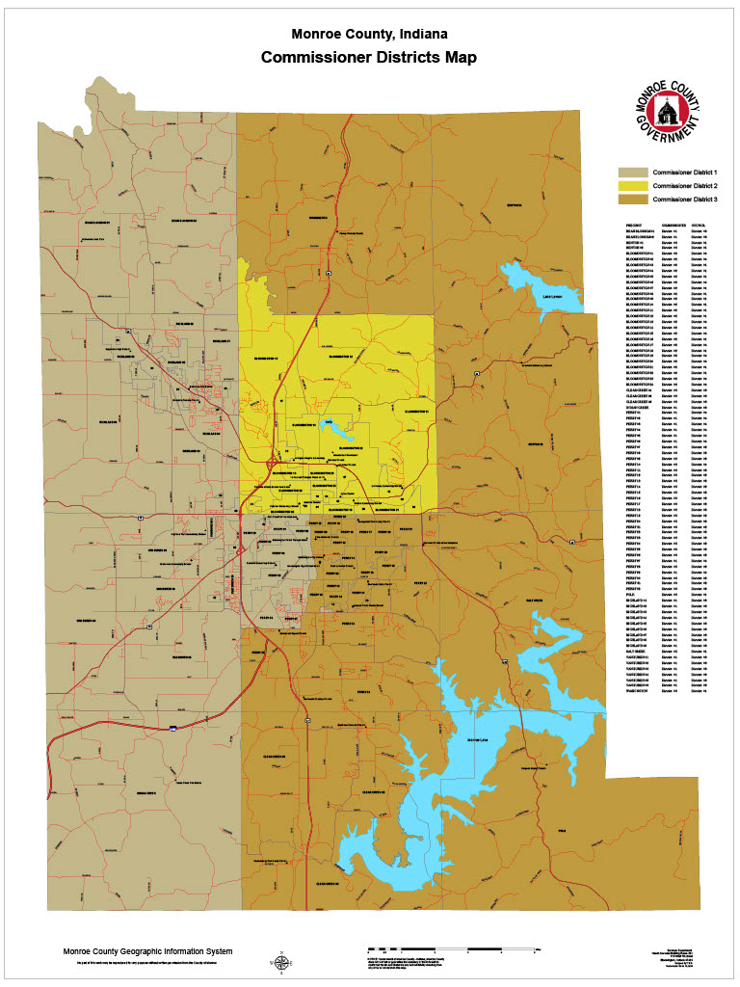
Gerrymandered? Monroe County House Districts
2011
Source: Monroe County Document Center
Notes:
This map shows portions of the five house districts that cover parts of Monroe County after the 2010 census. The red lines are major thoroughfares. The blue areas are lakes in this area.
Packing Democrats into one district (District 61 in the center of the map) reduced the number of Democratic house representatives elected by Monroe County from 2 to 1. Cracking made it impossible for Democrats to win in any of the other 4 districts.
Let’s think about the effects. Lake Monroe is in the lower right side of the map. It is located mainly in two rural districts, 60 and 65. This lake is the only source of drinking water for residents of Bloomington and parts of Monroe County. This mapping weakens city voters’ influence in state legislation about Lake Monroe. The few Monroe County voters in District 65 are cracked with other counties such as Lawrence, which is not dependent on the lake for its water.
When drawing voting districts, legislators need to consider the voters and the communities of interest that are important to the voters.

Slide 39
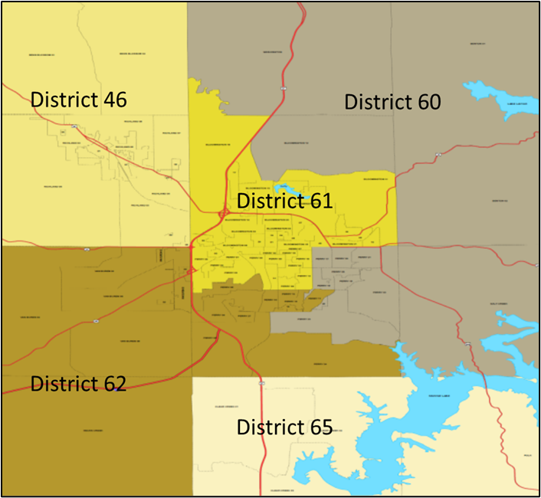
Gerrymandered? Monroe County House Districts
2011
Becky and Justin, let’s discuss this graphic.
Source: Monroe County Document Center
Notes:
This map shows portions of the five house districts that cover parts of Monroe County after the 2010 census. The red lines are major thoroughfares. The blue areas are lakes in this area.
Packing Democrats into one district (District 61 in the center of the map) reduced the number of Democratic house representatives elected by Monroe County from 2 to 1. Cracking made it impossible for Democrats to win in any of the other 4 districts.
Let’s think about the effects. Lake Monroe is in the lower right side of the map. It is located mainly in two rural districts, 60 and 65. This lake is the only source of drinking water for residents of Bloomington and parts of Monroe County. This mapping weakens city voters’ influence in state legislation about Lake Monroe. The few Monroe County voters in District 65 are cracked with other counties such as Lawrence, which is not dependent on the lake for its water.
When drawing voting districts, legislators need to consider the voters and the communities of interest that are important to the voters.

